Slide 1
Analysts Briefing
September 27, 2016

Slide 2
FY 2015 – 16 Snapshot
NET REVENUE PKR
 | Q1 | Q2 | Q3 | Q4 | Total | 2014-2015 | Growth/(Decline)
Export | 1,372,129,160 | 1,197,604,517 | 1,155,371,855 | 1,130,766,384 | 4,855,871,915 | 3,768,011,193 | 29%
Meatone | 249,978,925 | 194,664,701 | 256,729,687 | 308,111,488 | 1,009,484,801 | 763,323,820 | 32%
Instutuional | 145,878,956 | 187,737,005 | 155,223,174 | 125,082,125 | 613,921,260 | 236,567,285 | 160%
Khaas | 71,914,663 | 55,854,652 | 92,520,591 | 100,534,046 | 320,823,951 | 146,977,442 | 118%
QP | 95,477,760 |  |  |  | 95,477,760 | 69,872,244 | 37%
Total | 1,935,379,464 | 1,635,860,875 | 1,659,845,306 | 1,664,494,042 | 6,895,579,687 | 4,984,751,984 | 38%

Slide 3
Quarterly Performance Highlights by SBU

Slide 4
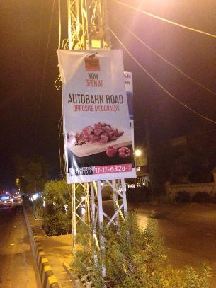
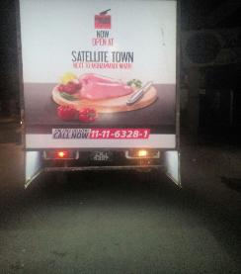
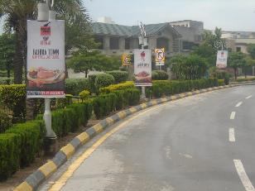
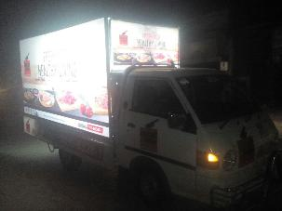
Meat One
Store Openings – Baharia Town Isb & Lahore, Chaklala 3 Rwp, E 11 Isb & Auto Bahn Hyderabad
As of June 30th, 2016 we have 33 active stores, and the expansion continues……

Slide 5
Meat One Business Results: Q4, 2016
 | Total Apr - March | Change vs SPLY | Change vs Q3, 2016 | Organic Apr - March | Change vs SPLY | Change Vs Q3, 2016
Volume | 434,593 tons | +16% | +8% | 419,132 tons | +11% | +1%
Value | 320 mln | +29% | +20% | 289 mln | +24% | +13%
Footfall | 187,243 | +23% | +13% | 179,409 | +16% | +5%

Slide 6
Khaas Meat: Q4 Business Results Summary
 | Total Apr - March | Change vs SPLY | Change vs Q3, 2016 | Organic Apr - March | Change vs SPLY | Change Vs Q3, 2016
Volume | 206,900 Tons | +37% | +1% | 93,072 tons | +24% | +23%
Value | 104 mln | +46% | +12% | 47 mln | +36% | +31%
Footfall | 82,291 | +29% | +4% | 37,479 | +9% | +10%

Slide 7
Institutional Sales: Q4 Business Performance
 | Q4, 2015 | Q4, 2016 | Change
Volume | 55 mln | 104 mln | +89%
Value | 99.6 tons | 191.7 tons | +93%
No of Customers | 69 | 125 | +81%

Slide 8
Export Channel Business Performance
 | Q4, 2016 | Change vs SPLY | Change vs Q3, 2016
Value | 1.14 bln | +3% | -1.5%
Volume | 2.32 mln tons | +4% | +0.2%
One of the largest organized grocery customers in KSA acquired

Slide 9
Corporate Governance

Slide 10
Reconstituted Board of Directors
Director | Profile
Muhammad Amin | Muhammed Amin is a Chartered Accountant by profession with a work experience of over 30 years at various management levels in Finance, Strategy, Sales, Marketing and General Management. He served as CEO of Mondelez Pakistan Limited ( previously Cadbury Pakistan Limited ) from 2004 to 2014. Prior to Mondelez, he was associated with Gillette for eleven years at various levels in Pakistan and overseas, the last being Regional Business Director, Gillette Middle East & Africa. Currently, he heads a startup known as Sunridge Foods Private Limited. He is a Director on the Board of Engro Foods Limited and a Governor on the Board of British Overseas School
Muhammad Ali | Mr. Muhammad Ali is an MBA and an LLM from the University of Toronto. He is an accomplished professional and businessman having worked with distinction in both domestic and internationally reputed organizations like Citibank N.A., Smith New Court Securities London, Indosuez W. I. Carr Securities, Threesixtydegreez LLC USA and Synergy Management Consulting LLC Dubai. Ali is the founder shareholder of Inbox Business Technologies, Converge Technologies, All Agro Real Estate and Al-Shaheer Corporation. Ali has also served as a Chairman of Securities and Exchange Commission of Pakistan and as a Director on the Boards of Karachi Stock Exchange and Engro Chemicals.
Rizwan Jamil | He completed his MBA in 1985 from the Institute of Business Administration, Karachi University. 22 years with Unilever, Rizwan has gathered a rich experience of Marketing, Sales and Business Management across a large number of business categories. In his last six years at Unilever, he was Head of the Tea Business Unit. Rizwan later joined Lafarge Pakistan, a subsidiary of the Paris based MNC, global leaders in construction materials. He worked there for over 6 years heading Business Strategy, Innovation & Marketing. A past Chairman of Pakistan Advertisers Society (PAS), Rizwan has been on the PAS Advertising Awards jury since its inception.
M Qaysar Alam | On the Boards of Directors of GS1 and Al Shaheer Corporation Ltd., Member Pakistan Advisory board ISCEA., President Supply Chain Association of Pakistan. Supply Chain Specialist, Consultant, Trainer and speaker at various business schools and forums. Worked for 29 years at Unilever Pakistan Ltd, where, for the last 8 years served as Vice President responsible for Supply Chain, its strategies and operations. Was on the Boards of Directors, Member of Audit committees and Management Committee of the Company. Key architect of Unilever Pakistan’s Supply Chain structure and processes making it forward looking, achieving efficiencies in speed, service and cost. Earlier worked at Exxon Pakistan, ARAMCO SA and taught Petroleum engineering at KU
Naveed Godil | Naveed Godil is a seasoned entrepreneur and founder of various Industries. He is a Director of the Al Shaheer Corporation Board since inception of the company. Besides Al Shaheer, he is CEO Universal packaging company Ltd., International packaging films Pvt. Ltd, 14th Street Pizza Company Pvt. Ltd. and NAFT Corporation. Mr. Godil is also director at Universal Carton industries LLC UAE and Dazzle FZCO Dubai.Mr. Godil has done his graduation from Preston University Karachi.
Rukhsana Asghar | For more than 30 years, Rukhsana has been at the forefront in the field of Human Resources in Pakistan and is one of the leading Human Resource professionals having core experience in senior Human Resource positions with top multinational companies (Unilever, Citibank and UBL) coupled with management consulting experience in the local corporate, multinational and public sectors. Previously held key positions include Group Head Human Resource, SEVP (UBL) & Director Human Resources (Citibank). Rukhsana Asghar is the Founder and CEO of Fulcrum (Pvt.) Ltd an HR & Business Consulting Company founded in 2015.
Noor Abid | Noor is a Fellow Chartered Accountant from Institute of Chartered Accountants in England and Wales. He started his career in 1976 in UK with KPMG. He has more than 35 years experience in the profession, across Europe, Middle East and Africa. Noor is currently a member of the Board of Directors of Kuwait Finance House, the largest Islamic Bank in Kuwait and Chairman of their Audit Committee, Meezan Bank Pakistan, Arcapita Investment Management Company in Bahrain and Chairman of their Audit and Risk Committee, Dr. Suleiman Fakeeh Hospital, the largest private hospital in Jeddah Saudi Arabia and Chairman of their Audit Committee. Noor is also a Member of the Board of Trustees at Accounting and Auditing Organisation for Islamic Financial Institutions (AAOIFI) in Bahrain.

Slide 11
Director Announcement
Sarfaraz Rehman – former CEO Engro Foods Limited – has assented to join the Al Shaheer Board.
Sarfaraz is a chartered accountant by qualification and has 30 plus years of professional work experience, mainly in the FMCG industry. He commenced his career with Unilever in 1983 and spent time in Finance, Marketing Services, Management Accounting and Cost Saving projects.
Moving on to Smithkline Beecham, he was involved in the Merger and Strategic Planning at the time of the merger.
Later, he spent several years abroad with Jardine Matheson/Olayan mainly in Finance and Business Development. He set up the first Logistics Service Provider in the Middle East.
Sarfaraz then moved to PepsiCo, managing the Pakistan/Afghanistan Business Unit. In 2000, Sarfaraz received the Chariman’s Award, whereas under his leadership the company won the Franchise of the Year in 2001. Later postings and consultancy assignments were outside Pakistan between 2003-2005.
On his return to Pakistan, Sarfaraz launched Engro Foods Limited (EFL) in 2005, and for over six years he was in the position of CEO. The company won the G20 World Top 15 company award in early 2012, as a leader in innovation worldwide. Sarfaraz then moved out of commercial operations into CSR with Dawood Foundation in November 2011.
Sarfaraz moved back to Engro Foods Limited as Chief Executive Officer with the Company winning the prestigious FT/IFC Transformational Business Award 2014 under his leadership

Slide 12
Code of Corporate governance
Internal Audit function has been set up & Grant Thompson have been appointed as internal auditors
Following committees are now functional:
Strategy Steering Committee headed by Sarfaraz Rahman
Audit Committee headed by Muhammad Amin
Human Resource Committee headed by Rukhsana Asghar
Cost Committee headed by Qaysar Alam

Slide 13
Poultry Project Update

Slide 14
Key Trends in food industry
Food sector has been one of the fastest growing sectors in the country.
Food companies such as Nestle, Engro Foods, National Foods are posting double digit growth in topline in recent years.
Growth in modern retailing in urban centers
Top End Retail (approx. 800 stores in 10 cities) accounts for 40% share of FMCG sales in top 10 cities and 22% of FMCG sales across Pakistan ¹
Growth in processed meat category - 10%²
Growth in local restaurants chains.
¹ Nielsen
² Euromonitor

Slide 15
Key trends in food industry
Quick service restaurants are asking for ready to fry/grill products.
Population growth and increased rural-urban migration (~2% per year)
Customers are becoming more and more aware of poor hygiene and quality of food / food ingredients in unregulated market.
Value added meat /non meat products are becoming regular part of consumer grocery lists, particularly in convenience segment
Emergence of several new players in value added meat processing over the last few years.
Changing consumer habit of dining out and ordering in.

Slide 16
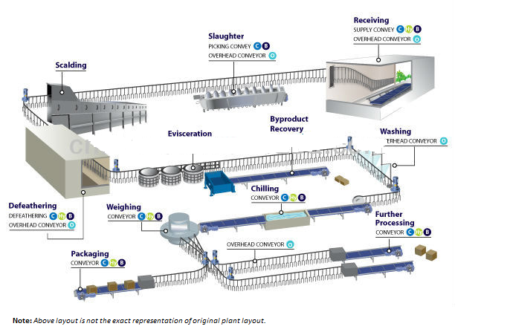
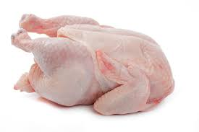
Project
Poultry Processing
Fresh and Frozen poultry cuts
Value Added Processing
RTC/RTE
Snacks/Flour products

Slide 17
Product Portfolio
Product Portfolio
Primary
Value Added-
Continental
Deli
Fresh
Frozen
Ethnic
others
Meat Based
Flour Based
Bakery/Snacks
Parathas

Slide 18
Project Status
Machinery
Almost 90% of the equipment has arrived and has purchased from leading manufacturers from Europe
Ground Work
Machine installation will start in Nov. 2016

Slide 19
Project Status
Food Research Facility
Food research facility is being built that is going to be the key building block of the business.
Professional Chefs and meat/product experts will be taken on board to develop authentic recipes.
One of the most experienced product expert from the region has been taken on board.
Technical/Business Consultants
Experts are on board for different aspects of the project
Civil Consultant: Akbar and Associates
Refrigeration Consultants: IceandEasy ,Netherlands
Electrical Consultants: United Engineering

Slide 20
Frozen & Fresh Fruit and Vegetable Plant
Plant / machinery has been acquired
Land earmarked for construction
Most experienced consultant in Pakistan has been engaged for project development
Completion date is expected to be December 2017

Slide 21
Your questions….. Thank you

