Slide 1
Analysts Briefing
October 31, 2016

Slide 2
Reconciliation of Profitability
RECONCILIATION OF PBT FOR QE SEP 16
 |  | Q1-17 Vs Q1-16 |  | Q1-17 Vs Q4-16
 |  | ----------------Rs. In '000 ---------------
PBT |  | 81,541 |  | 81,714
Other Income |  | (42,518) |  | (8,737)
Other Expenses |  | (1,642) |  | 10,028
Overheads - before dep |  | (47,648) |  | 51,403
Depreciation method change |  | 4,368 |  | (26,670)
Profit from Qurbani Project |  | 21,917 |  | 61,646
Reversal of Provision for W/H tax - COGS |  | - |  | (11,184)
Variance in Finance Cost |  | 3,611 |  | (5,294)
Extraordinary spoilage |  | (67) |  | 9,696
 |  | 19,562 |  | 162,601
EXPORT SEGMENT:
Impact of increase in Purchase Cost |  | (35,850) |  | (107,760)
Impact of reduction in other direct cost (cargo related) |  | 18,305 |  | 2,065
Surplus Profit/(Loss) on Wakkhar |  | 2,665 |  | (26,671)
Loss of Export CM on reduced volume |  | (43,146) |  | (36,825)
Reduction in Export price/Ex rate |  | (4,202) |  | (7,858)
RETAIL AND B2B SEGMENT:
Meat One & Khaas: CM Profit/Loss due to revenue variance |  | 8,559 |  | (11,425)
Meat One & Khaas: CM Profit/Loss due to increase/decrease in CM |  | 1,368 |  | (8,322)
CM increase from PAF/Navy Sales |  | 2,211 |  | 3,666
PBT for QE Sep 16 |  | (30,528) |  | (30,529)

Slide 3
Q1 2016 – 17 Snapshot
SBU | Revenue PKR Million | Change vs SPLY
Export | 930.6 | -32%
Meat One | 415.3 | +20%
Khaas Meat | 73.9 | +3%
Institutional Sales | 78.5 | +31%
Tender Business | 47.6 | -45%
TOTAL | 1545.9 | -20%

Slide 4
Sales Mix QE Sep 2016 vs 2015

Slide 5
Business Highlights

Slide 6
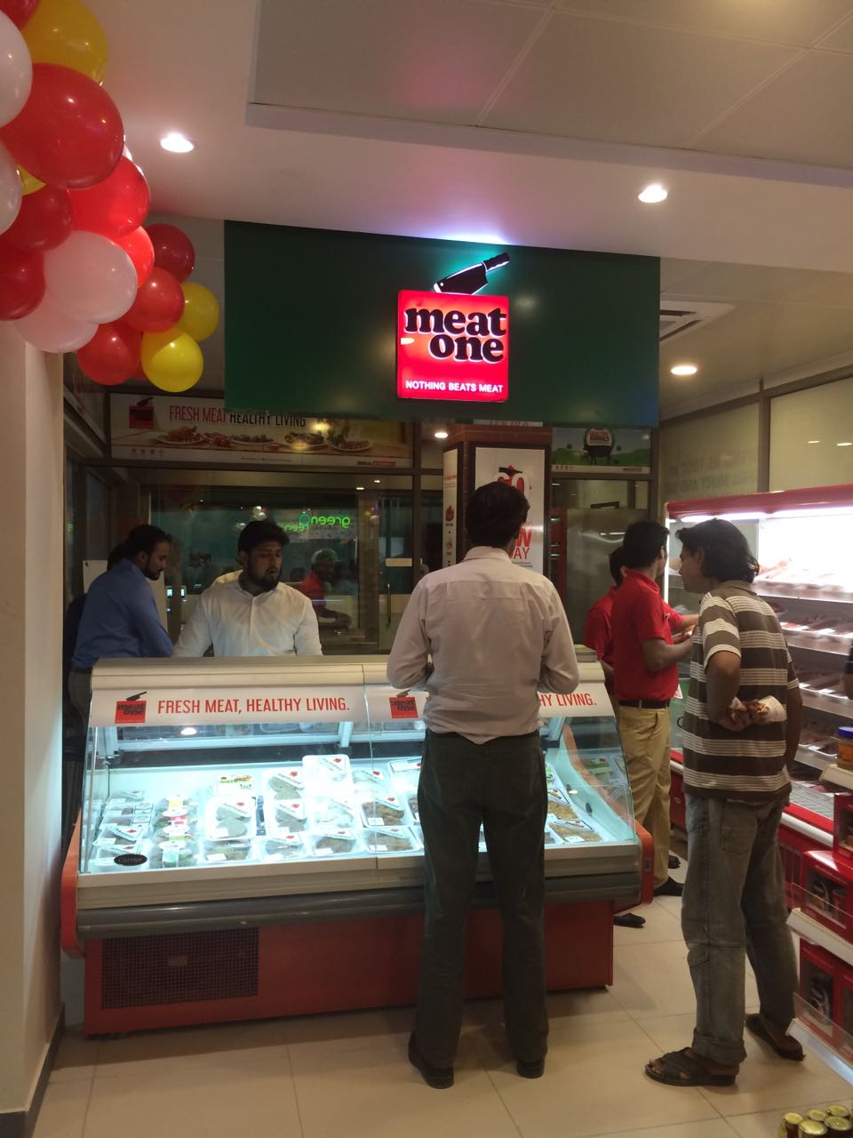
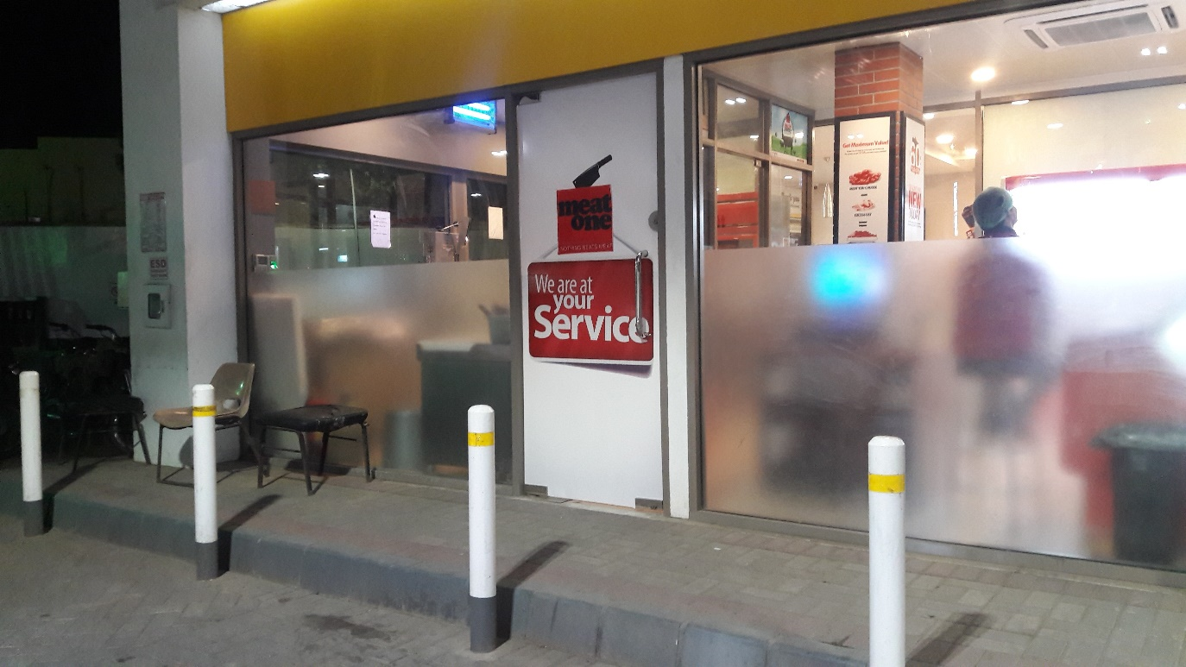
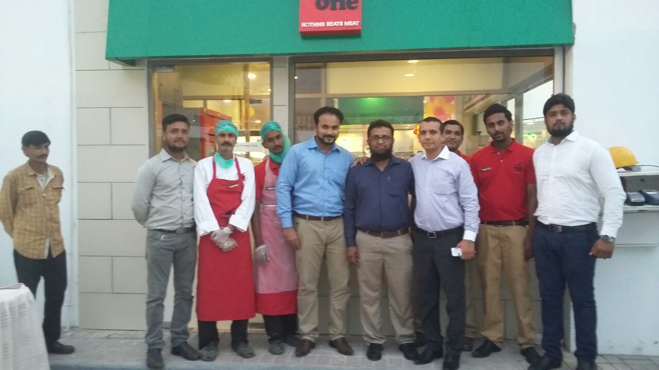
Meat One
The first location with Shell fuel retail was energized at Shell Askari Filling Station
Our second location with Al Fatah Lahore opened in DHA, Karachi
Our third location with Bin Hashim Store opened in FB Area, Karachi
As of September 30th, 2016 we have 36 active stores, and the expansion continues……

Slide 7
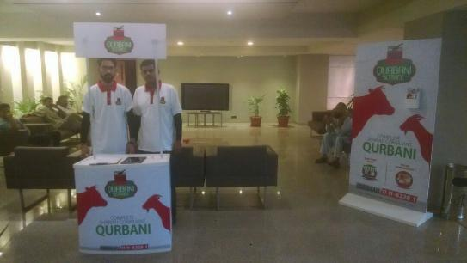
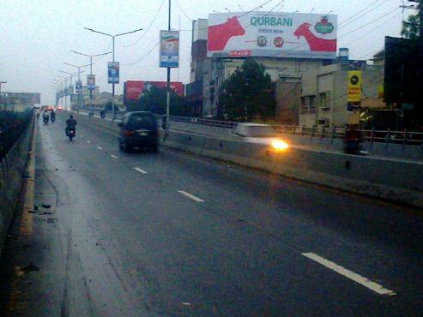
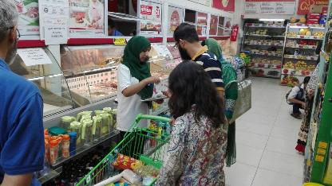
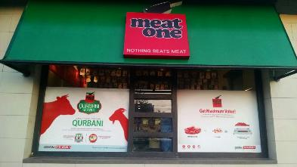
Meat One: Eid Ul Adha Qurbani

Slide 8
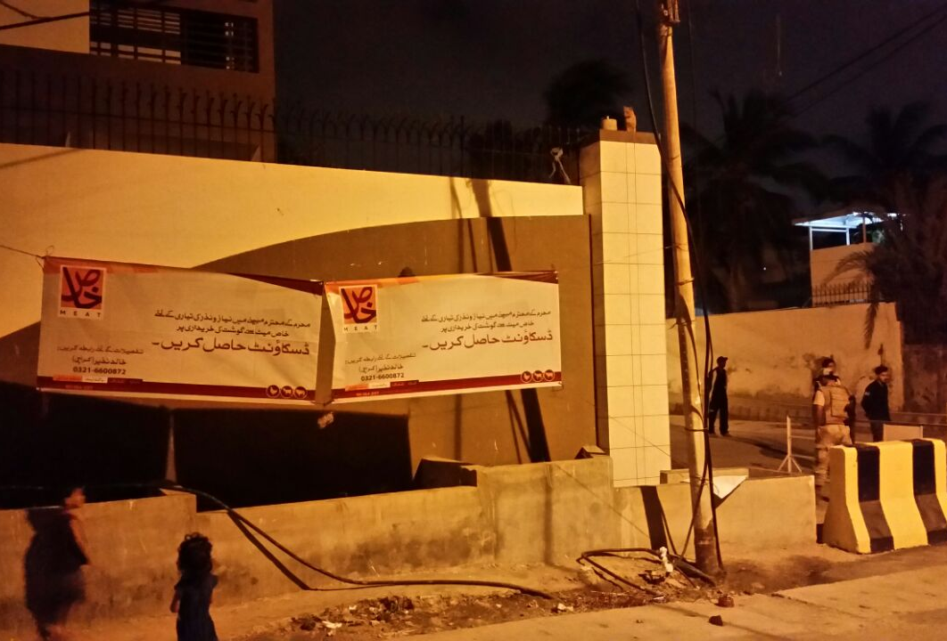
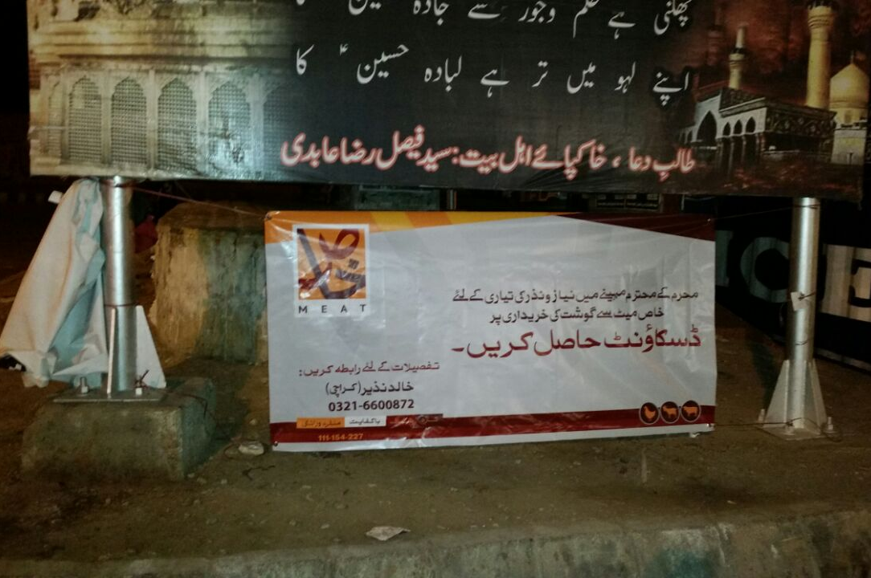
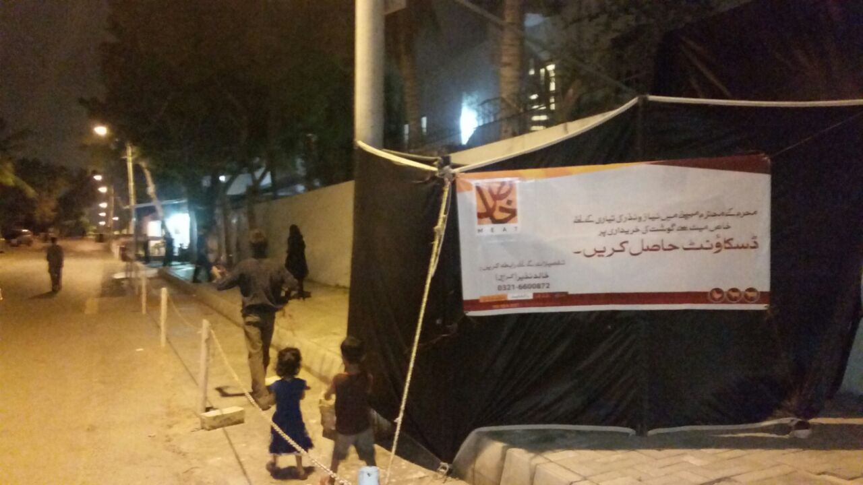
Khaas Meat:
Network further consolidated and 3 more unprofitable locations closed down
Our network size of 15 shops vs 27 shops last year, still clocked a modest growth of 3%
Special Muharram offer

Slide 9
Institutional Sales: Q4 Business Performance
Core business showed robust 30% growth
Added additional 15 customers bringing our penetration to 140 accounts:
- Renewed PAF tender with addition of chicken business

Slide 10
Export Channel Business Highlight
While there was considerable pressure on volumes and margin, we have initiated sales of red offal to UAE, successfully diversifying our portfolio
Recovery in the current period is promising & top line growth is expected in the coming quarters

Slide 11
Poultry Project Update

Slide 12
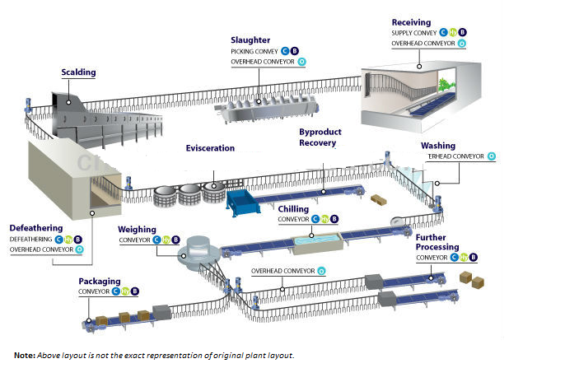
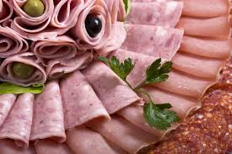
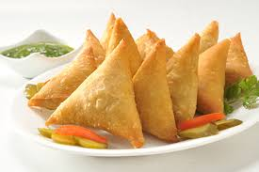
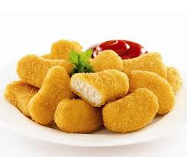
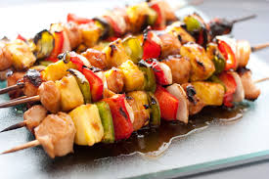
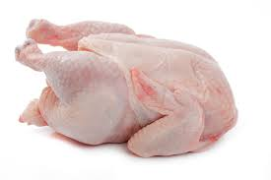
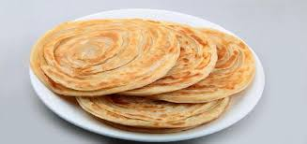
Project
Poultry Processing
Fresh and Frozen poultry cuts
Value Added Processing
RTC/RTE
Snacks/Flour products

Slide 13
Project Status
Machinery
Almost 90% of the equipment has arrived and has purchased from leading manufacturers from Europe
Ground Work
Machine installation will start in Nov. 2016
Product Development
Extensive R & D underway
State of the Art Food Research Center being established in Karachi

Slide 14
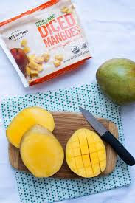
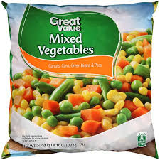
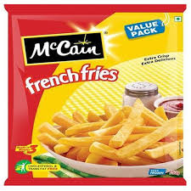
Frozen & Fresh Fruit and Vegetable Plant
Plant / machinery has been acquired
Land earmarked for construction
Most experienced consultant in Pakistan has been engaged for project development
Completion date is expected to be December 2017

Slide 15
Your questions….. Thank you

